Slide 1
2.5 Ethical Egoism
1-<number>

Slide 2
Definition of Ethical Egoism
Each person should focus exclusively on his or her self-interest
Morally right action: that action that provides self with maximum long-term benefit
Ayn Rand, author of The Fountainhead and Atlas Shrugged, espoused a theory akin to ethical egoism
1-<number>

Slide 3
Case for Ethical Egoism
It is practical since we are already inclined to do what’s best for ourselves
It is better to let other people take care of themselves
The community can benefit when individuals put their well-being first
Other moral principles are rooted in the principle of self-interest
1-<number>

Slide 4
Case Against Ethical Egoism
An easy moral philosophy may not be the best moral philosophy
We know a lot about what is good for someone else
Self-interest can lead to blatantly immoral behavior
Other moral principles are superior to principle of self-interest
People who take the good of others into account lead happier lives
By definition, does not respect the ethical point of view
Not a workable ethical theory
1-<number>

Slide 5
2.6 Kantianism
1-<number>

Slide 6
Critical Importance of Good Will
Good will: the desire to do the right thing
Immanuel Kant: Only thing in the world that is good without qualification is a good will
Reason should cultivate desire to do right thing
1-<number>

Slide 7
Categorical Imperative (1st Formulation)
Act only from moral rules that you can at the
same time will to be universal moral laws.
1-<number>

Slide 8
Illustration of 1st Formulation
Question: Can a person in dire straits make a promise with the intention of breaking it later?
Proposed rule: “I may make promises with the intention of later breaking them.”
The person in trouble wants his promise to be believed so he can get what he needs.
Universalize rule: Everyone may make & break promises
Everyone breaking promises would make promises unbelievable, contradicting desire to have promise believed
The rule is flawed. The answer is “No.”
1-<number>

Slide 9
A Quick Check
When evaluating a proposed action, reverse roles
What would you think if that person did the same thing to you?
Negative reaction → evidence that your will to do that action violates the Categorical Imperative
1-<number>

Slide 10
Categorical Imperative (2nd Formulation)
Act so that you treat both yourself
and other people as ends in themselves
and never only as a means to an end.
This is usually an easier formulation to work
with than the first formulation of the
Categorical Imperative.
1-<number>

Slide 11
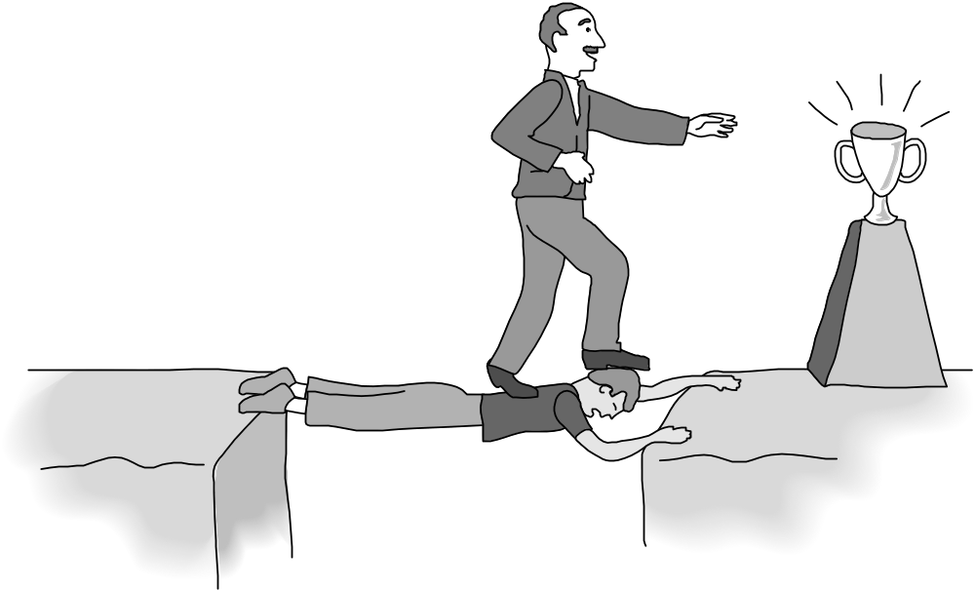
Kant: Wrong to Use Another Person Solely as a Means to an End
1-<number>

Slide 12
Plagiarism Scenario
Carla
  Single mother
  Works full time
  Takes two evening courses/semester
History class
  Requires more work than normal
  Carla earning an “A” on all work so far
  Carla doesn’t have time to write final report
Carla purchases report; submits it as her own work
1-<number>

Slide 13
Kantian Evaluation (1st Formulation)
Carla wants credit for plagiarized report
Rule: “You may claim credit for work performed by someone else”
If rule universalized, reports would no longer be credible indicator’s of student’s knowledge, and professors would not give credit for reports
Proposal moral rule is self-defeating
It is wrong for Carla to turn in a purchased report
1-<number>

Slide 14
Kantian Evaluation (2nd Formulation)
Carla submitted another person’s work as her own
She attempted to deceive professor
She treated professor as a means to an end
  End: passing the course
  Means: manipulate professor
What Carla did was wrong
1-<number>

Slide 15
Case for Kantianism
Aligns with common moral concern: “What if everyone acted that way?”
Produces universal moral guidelines
Treats all persons as moral equals
1-<number>

Slide 16
Perfect and Imperfect Duties
Perfect duty: duty obliged to fulfill without exception
  Example: Telling the truth
Imperfect duty: duty obliged to fulfill in general but not in every instance
  Example: Helping others
1-<number>

Slide 17
Case Against Kantianism
Sometimes no rule adequately characterizes an action
Sometimes there is no way to resolve a conflict between rules
  In a conflict between a perfect duty and an imperfect duty, perfect duty prevails
  In a conflict between two perfect duties, no solution
Kantianism allows no exceptions to perfect duties
Despite weaknesses, a workable ethical theory
1-<number>

Slide 18
2.7 Act Utilitarianism
1-<number>

Slide 19
Principle of Utility
Jeremy Bentham and John Stuart Mill
An action is good if its benefits exceeds its harms
An action is bad if its harms exceed its benefits
Utility: tendency of an object to produce happiness or prevent unhappiness for an individual or a community
Happiness = advantage = benefit = good = pleasure
Unhappiness = disadvantage = cost = evil = pain
1-<number>

Slide 20
Principle of Utility
(Greatest Happiness Principle)
An action is right (or wrong) to the extent
that it increases (or decreases) the
total happiness of the affected parties.
1-<number>

Slide 21
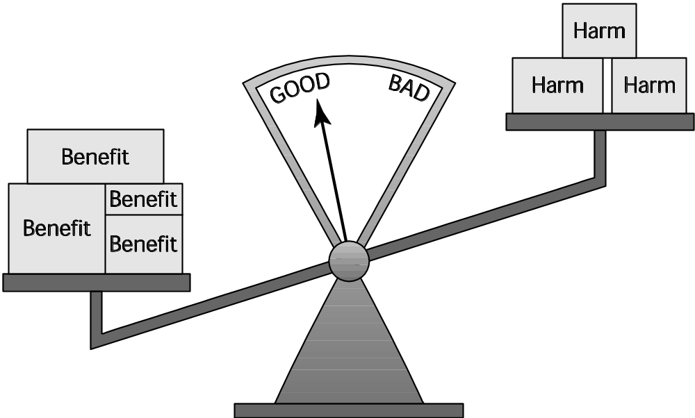
Principle of Utility
1-<number>

Slide 22
Act Utilitarianism
Utilitarianism
  Morality of an action has nothing to do with intent
  Focuses on the consequences
  A consequentialist theory
Act utilitarianism
  Add up change in happiness of all affected beings
  Sum > 0, action is good
  Sum < 0, action is bad
  Right action to take: one that maximizes the sum
1-<number>

Slide 23
Bentham: Weighing Pleasure/Pain
Intensity
Duration
Certainty
Propinquity
Fecundity
Purity
Extent
1-<number>

Slide 24
Highway Routing Scenario
State may replace a curvy stretch of highway
New highway segment 1 mile shorter
150 houses would have to be removed
Some wildlife habitat would be destroyed
1-<number>

Slide 25
Evaluation
Costs
  $20 million to compensate homeowners
  $10 million to construct new highway
  Lost wildlife habitat worth $1 million
Benefits
  $39 million savings in automobile driving costs
Conclusion
  Benefits exceed costs
  Building highway a good action
1-<number>

Slide 26
Case for Act Utilitarianism
Focuses on happiness
Down-to-earth (practical)
Comprehensive
1-<number>

Slide 27
Case Against Act Utilitarianism
Unclear whom to include in calculations and how far out into the future to consider
Too much work
Ignores our innate sense of duty
We cannot predict consequences with certainty
Susceptible to the problem of moral luck
Overall, a workable ethical theory
1-<number>

